Slide 1
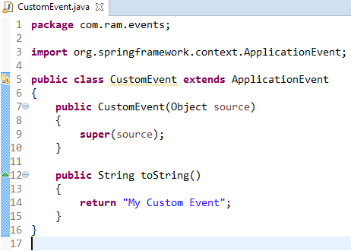
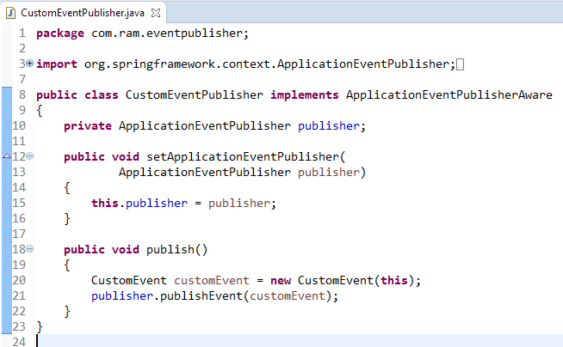
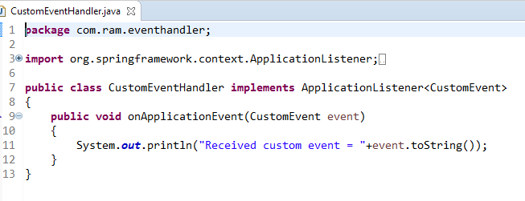
Custom Events in Spring
CustomEventPublisher
Publish
CustomEvent
Receive
CustomEventHandler

Slide 2
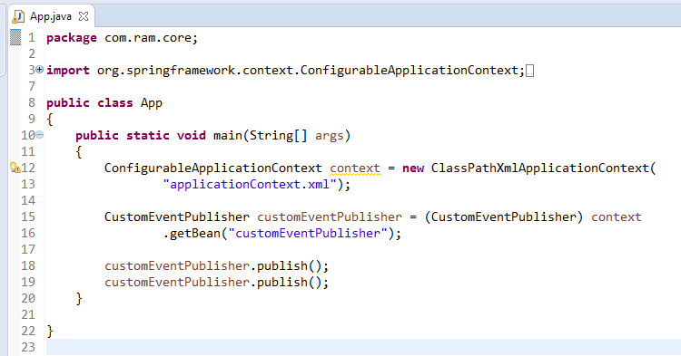

Custom Events in Spring

Slide 3

Custom Events in Spring

